Slide 1

COFFEE SALES ANALYSIS
By Satyashree Sahu Pawar
ZION TECH HUB

Slide 2
Content
Project Description
Approach
Tech-Stack Used
Insights
Results

Slide 3

Project Description
Project Purpose:
The primary objective of the Coffee Sales Analysis project is to offer a thorough understanding of the sales performance of a coffee business throughout recent years.
Business Problem:
Improve competitiveness in the Market Using and increase sales.
Meet consumer Demand.
Dataset Details:
Contains information on over 1000 customers , their country, city, type of coffee they used, Type of Roast they preferred , total sales done as per individual customer and order per date.
Using advanced data analytics and visualization methods, the project investigates diverse elements of sales, customer interactions, and product preferences.
Ultimately, the aim is to empower stakeholders with actionable insights, facilitating strategic decision-making and fostering business growth.

Slide 4
Approach
Data Cleaning and Formatting:
Consolidate data from three separate worksheets by importing it into a single worksheet to create a final dataset.
Create Pivot Tables:
Used Pivot Tables to summarize and aggregate data. Create tables to analyze total sales, quantity ordered, and customer contributions. This will provide a snapshot of the overall data.
Data Visualization:
Implement various Excel chart types for visualization, such as line charts for sales trends, bar charts for customer contributions, and pie charts for quantity ordered by coffee type. Utilize color-coding and labels for clarity.
Key Metric Calculations:
Calculate key metrics such as total sales and total quantity ordered. Use Excel formulas to derive these metrics from your data.
Filtering Options:
Implement Excel's filtering options to allow users to interactively explore the data. Utilize dropdown lists or slicers for filtering by years, loyalty cards, size, and roast types.
Dashboard Creation:
Design a cohesive dashboard that incorporates all the visualizations, key metrics, and filtering options. Ensure that the dashboard is user-friendly, visually appealing, and effectively communicates the insights derived from the data.

Slide 5
Tech-Stack Used
Microsoft Excel 365
Microsoft Power Point

Slide 6
Data Cleaning
Initially, there is a dataset table comprising three worksheets named Orders, Customer, and Products.
01
The first step involves extracting the year from the Order_Date using the formula = YEAR(Order_Date).
02
Subsequently, data is extracted from various worksheets, including Loyalty_Card, Country, Coffee_Type, Roast_Type, and Unit_Price, utilizing the INDEX and MATCH functions.
03
To determine Total_Sales, the formula =Unit_Price*Quantity is applied.
04
Additionally, the Coffee_Type and Roast_Type are renamed to their full names using the IFS formula.
05

Slide 7

Insights

Slide 8
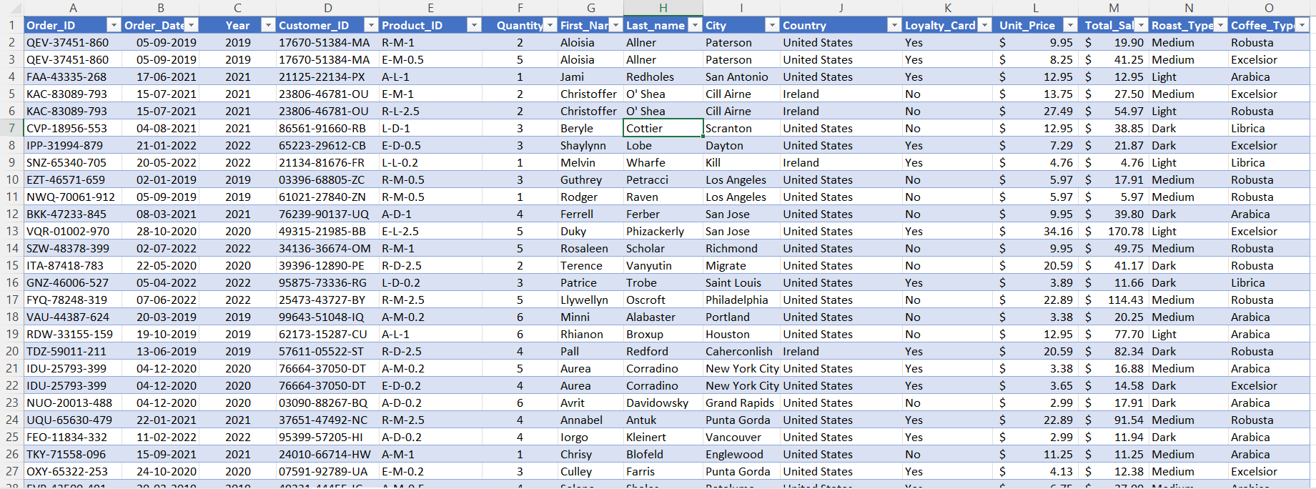
Final Data Set

Slide 9
Trend Analysis:
Trend of Total Sales for Coffee Types in each year
 | Sum of Total_Sales
Year | Arabica | Excelsior | Librica | Robusta | Grand Total
2019 | $ 2926.63 | $ 3481.46 | $ 3378.005 | $ 2401.07 | $ 12187.165
2020 | $ 3356.415 | $ 3663.41 | $ 2604.455 | $ 2493.265 | $ 12117.545
2021 | $ 4045.63 | $ 3469.64 | $ 3836.695 | $ 2414.145 | $ 13766.11
2022 | $ 1439.82 | $ 1691.93 | $ 2234.92 | $ 1696.765 | $ 7063.435
Grand Total | $ 11768.495 | $ 12306.44 | $ 12054.075 | $ 9005.245 | $ 45134.255
The trend analysis reveals fluctuations in the total sales of different coffee types over the years 2019 to 2022. Notable observations include a substantial increase in Arabica sales from 2019 to 2021, reaching 4045.63 but a significant decrease in 2022 to 1439.82. Excelsior exhibited a steady rise until 2021, followed by a decline in 2022. Librica experienced a peak in sales in 2021, whereas Robusta showed a consistent decline over the analyzed period.

Slide 10
Visualization
Year
Highest Sales Year : 2021
Total Sales :$ 13766.11
Most Demand Coffee Type : Librica
With Sales : $12054.075
Lowest Sales Year : 2022
Total Sales :$ 7063.435
Most Demand Coffee Type : Librica
With Sales : $ 2234.92

Slide 11
Sales by County:
Country | Total Sales
Ireland | $ 6696.865
United Kingdom | $ 2798.505
United States | $ 35638.885
Grand Total | $ 45134.255

Slide 12
Visualization
The United States dominates the sales with a substantial amount of $35,638.885, followed by Ireland with $6,696.865. The United Kingdom trails behind with $2,798.505 in total sales.

Slide 13
Top 5 Customers:
Customer ID | Total_Sales
27930-59250-JT | $ 317.07
86579-92122-OC | $ 307.045
16880-78077-FB | $ 289.11
16982-35708-BZ | $ 281.675
19485-98072-PS | $ 278.01
Grand Total | $ 1472.91

Slide 14
Visualization
Sales
The Customer ID 27930-59250-JT has the highest sales with $317.07, followed closely by Customer ID 86579-92122-OC with $307.045. The third-highest sales are attributed to Customer ID 16880-78077-FB with $289.11.
Customer_ID

Slide 15
Product Analysis:
Row Labels | Count of Quantity
Arabica | 947
Excelsior | 872
Librica | 854
Robusta | 878
Grand Total | 3551

Slide 16
Visualization
Arabica has the highest total quantity, amounting to 947 units. Following closely, Excelsior and Robusta have quantities of 872 and 878 units, respectively. Librica, with a total quantity of 854 units, is also a significant contributor to the overall inventory.

Slide 17
Loyalty Cards: Understand the impact of loyalty programs on sales.
Filtering Options:
With a negative loyalty card status, there are 521 customers, contributing to sales totaling $24,216.406.
On the other hand, with a positive loyalty card status, there are 479 customers, and the corresponding sales amount to $20,917.8.
In conclusion, the presence of a loyalty card appears to influence customer engagement and overall sales, with a higher number of customers associated with negative loyalty cards contributing to higher sales.

Slide 18
Results
Trend Analysis:
The trend analysis highlights dynamic shifts in sales for different coffee types. Adaptability is crucial in responding to evolving consumer preferences. especially considering the significant drop in Arabica sales in 2022.
Country Sales Analysis:
The United States stands out as a dominant market, contributing significantly to total sales. Stakeholders may consider leveraging successful strategies from the U.S. market when expanding or optimizing operations in Ireland and the United Kingdom.
Customer Sales Analysis:
Recognizing high-performing customers with no loyalty card, such as those identified by Customer IDs 27930-59250-JT and 86579-92122-OC, has the highest sales ,suggests the importance of personalized engagement and loyalty programs. Strengthening relationships with these customers could yield continued success.
Coffee Type and Quantity:
Arabica emerges as the most popular coffee type, emphasizing the need to ensure sufficient inventory and targeted marketing for this preferred variety. Additionally, insights into the popularity of Robusta, Excelsior, and Librica can guide inventory management and marketing efforts.
Loyalty Card Analysis:
The data indicates that a negative loyalty card status corresponds with higher sales. This prompts further investigation into the factors influencing customer behavior with loyalty cards.

Slide 19

Recommendations
1. Adjust how we promote our coffee to match what people like, so more folks can enjoy their favorite flavors.
2. Think about growing our business in the U.S., where there's a lot of potential for success.
3. Get closer to our best customers by making our interactions more personal and friendly.
4. Make sure we have enough of the coffee people love in stock, so they can always get what they want.
5. Take another look at our loyalty card program to see how it affects what customers buy and how much they spend.

Slide 20
THANK YOU

